Slide 1
CLASS 03: BUILD PROGRAM LOGIC(02)
Intro If-elif statement, nested If statement
and program implementation

Slide 2
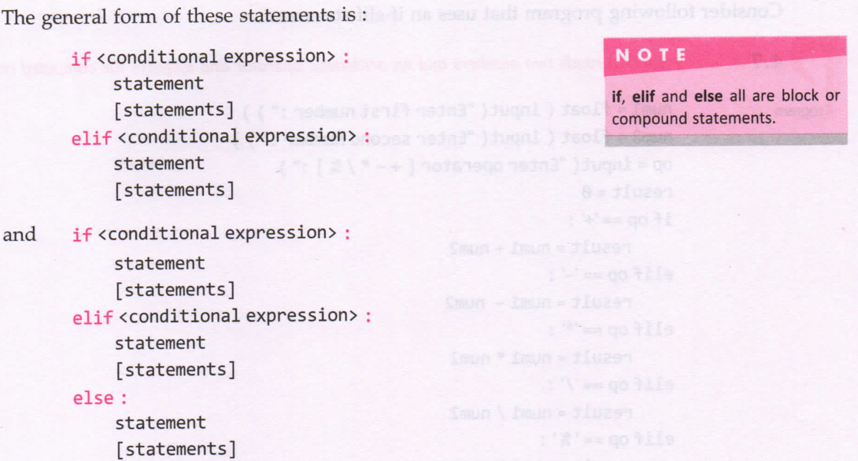
if-elif STATEMENT

Slide 3
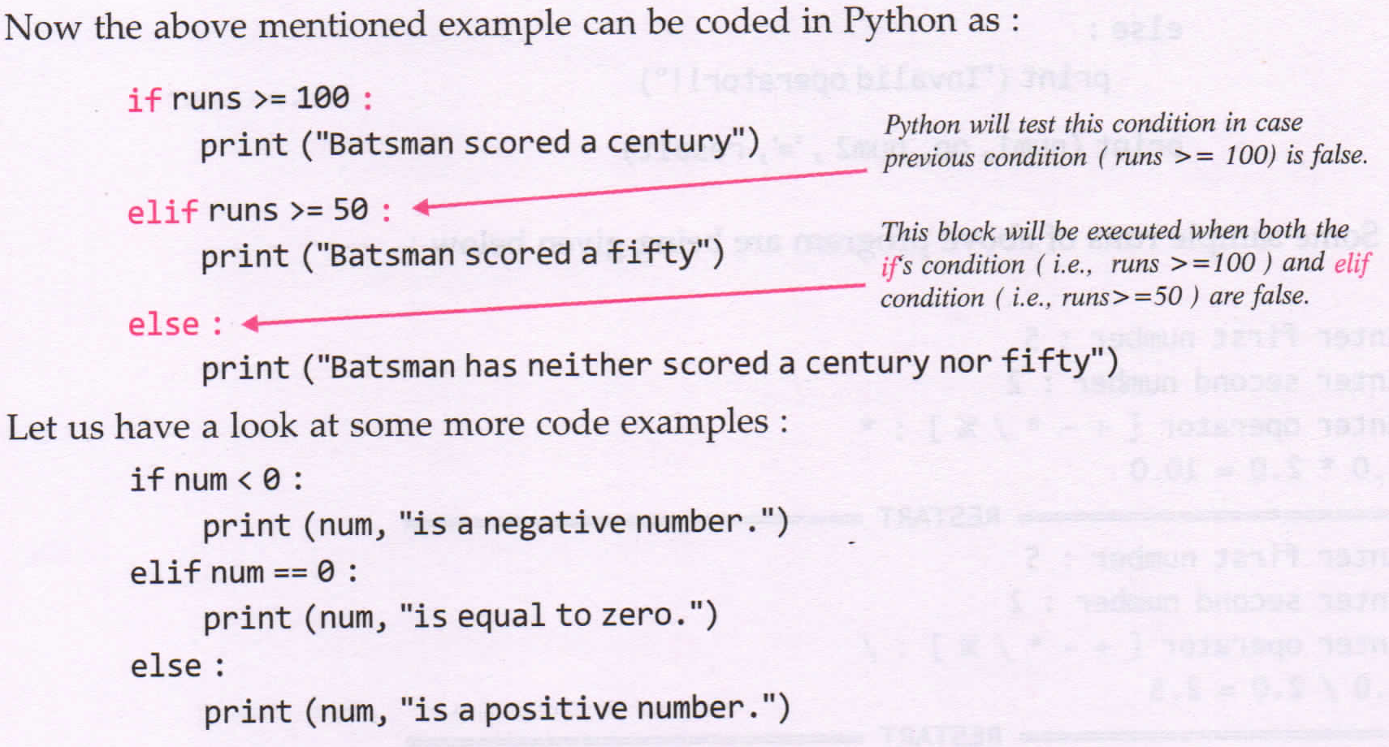

Slide 4
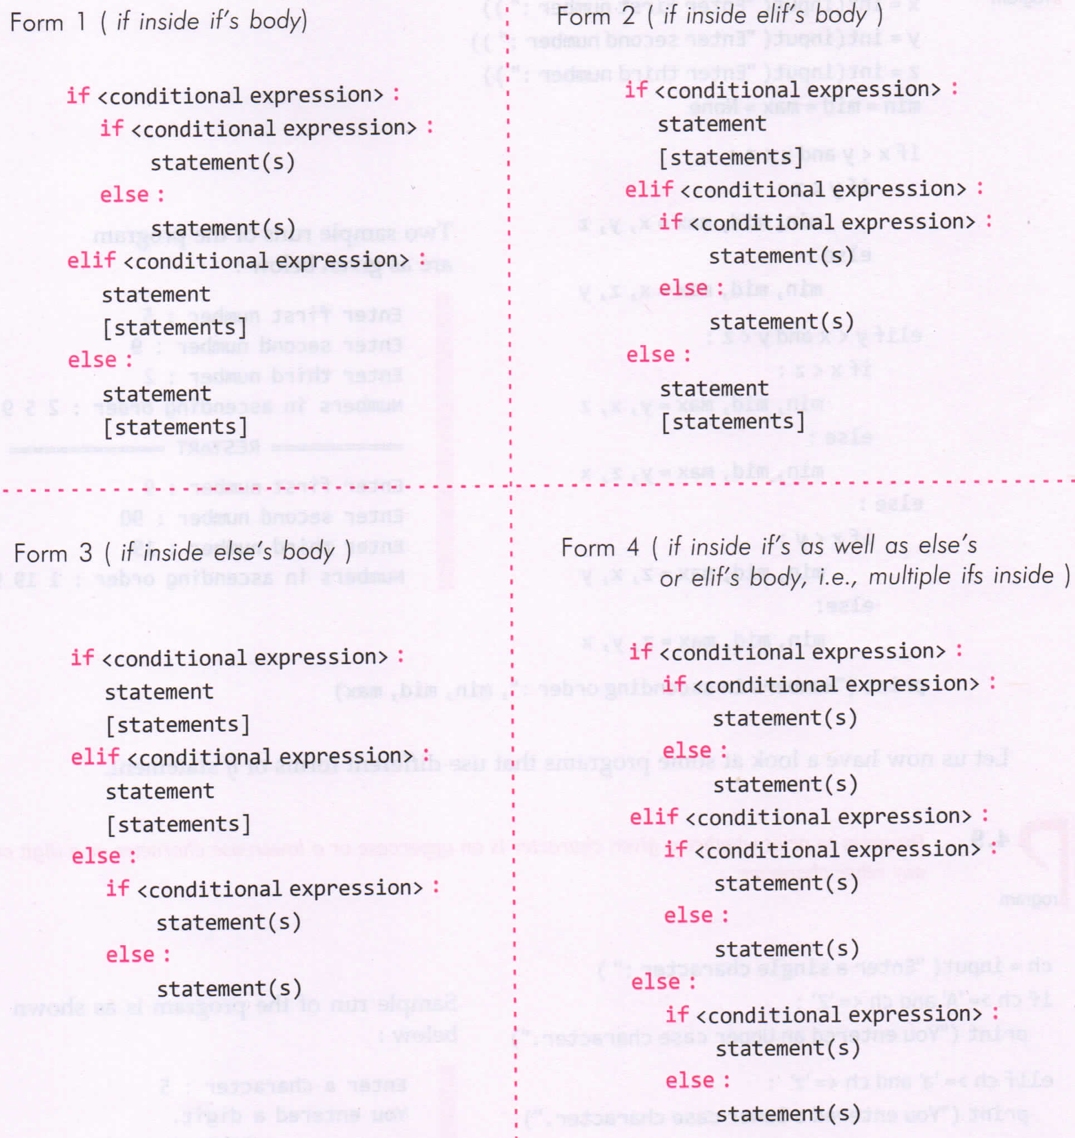
nested-if STATEMENT

Slide 5
Programs
P1: Program to print whether a given character is an uppercase character or a lowercase character or any other character.
P2: Program to calculate and print roots of a quadratic equation:
ax² + bx + c = 0 (a!=0)

Slide 6
HW Programs
P1: Program that reads two numbers and an arithmetic operator and displays the computed result.
Hint: Take two numbers as input and an operator. Check which type of operator (+,-,*,/,//,%). Perform operation and show result.

